Slide 1






Project #1
Lauren
Jim
Dylan
Raj
Angie
Notes:
DYLAN

Slide 2
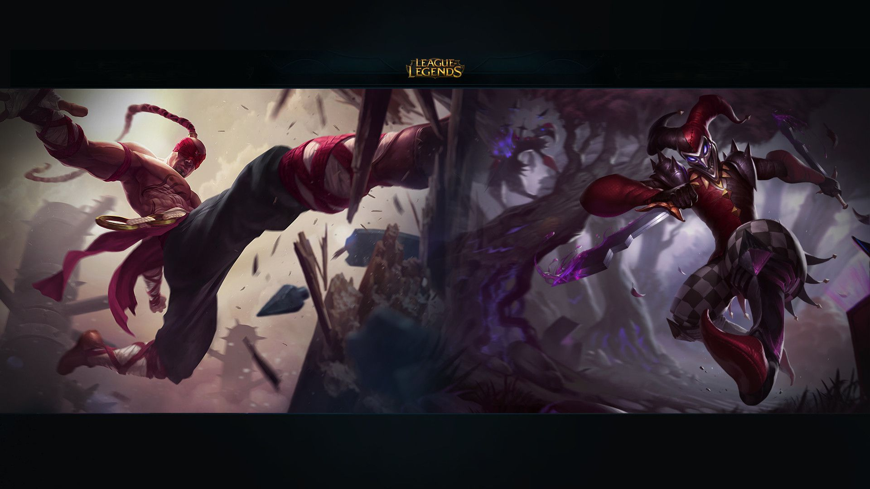

TEAM-BASED STRATEGY GAME
BLUE TEAM
RED TEAM
Five Players per Team
Five Champions per Team
Objective: Destroy Red team base
Five Players per Team
Five Champions per Team
Objective: Destroy Blue team base
MINION
TOWERS
CHAMPIONS
Bots: Supportive role / pawns
Six towers per team (Forts)
Over 140 champions
Different skills, strengths and weaknesses

Slide 3
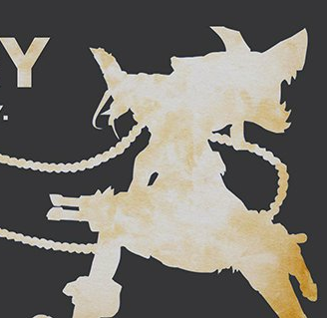




Champion Roles
FARM. KITE. CARRY
SMITE. GANK. TAX
THE WORLD IS A DESERT. I AM THE OASIS
SUPPORT
TOP
AD CARRY
JUNGLE
MID
PROTECT. HARASS. DOMINATE
PUSH. CARRY. ROAM
Notes:
DYLAN
Introduce character roles and explain a bit about them

Slide 4
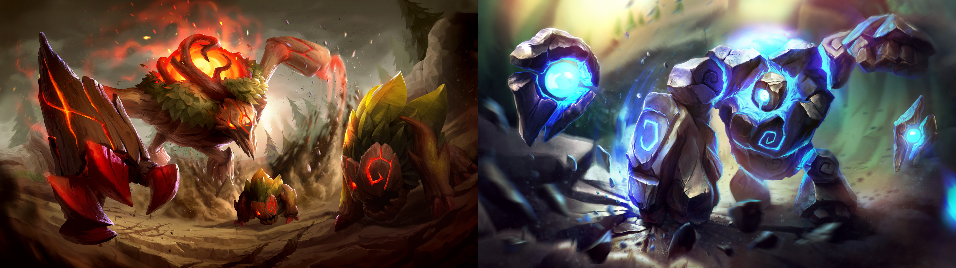





CREATE A SUPERSQUAD
ANALYSIS WORKFLOW
STEP1
STEP2
STEP3
STEP4
STEP5
Identify Data Source
Clean and Explore Data
Perform Initial Descriptive Data Analysis
Conduct Correlation Analysis
Create Algorithm to Calculate Viability Score

Slide 5

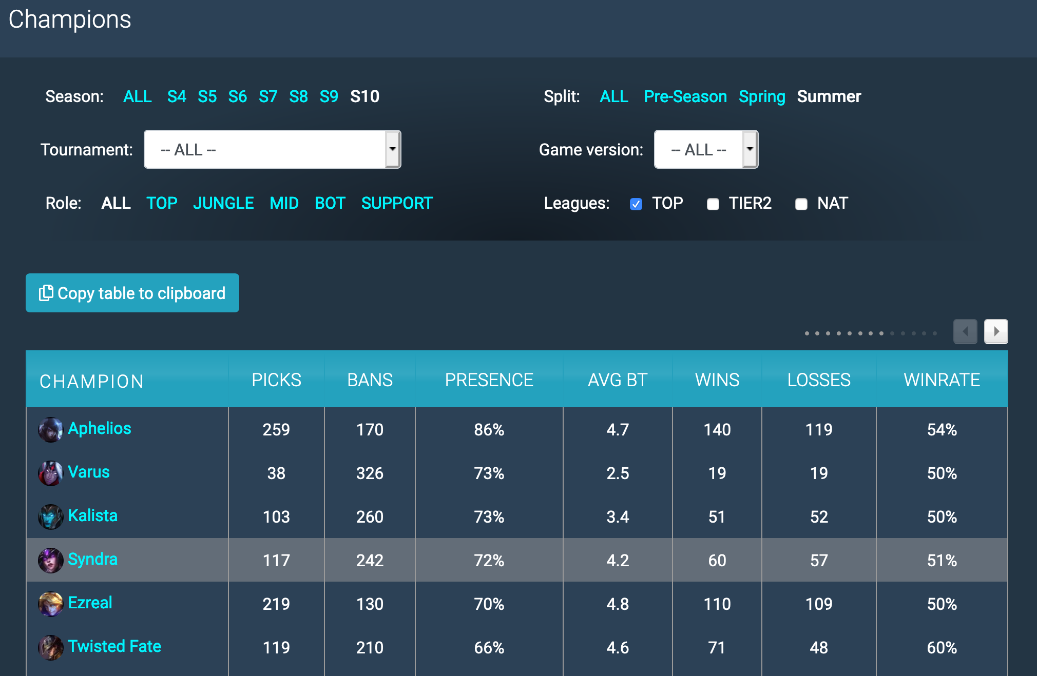

Data Sources
Analysis Workflow
User Champion Picks
2018-2020
Notes:
RAJ
Data used to identify the most popular player of the last two years

Slide 6
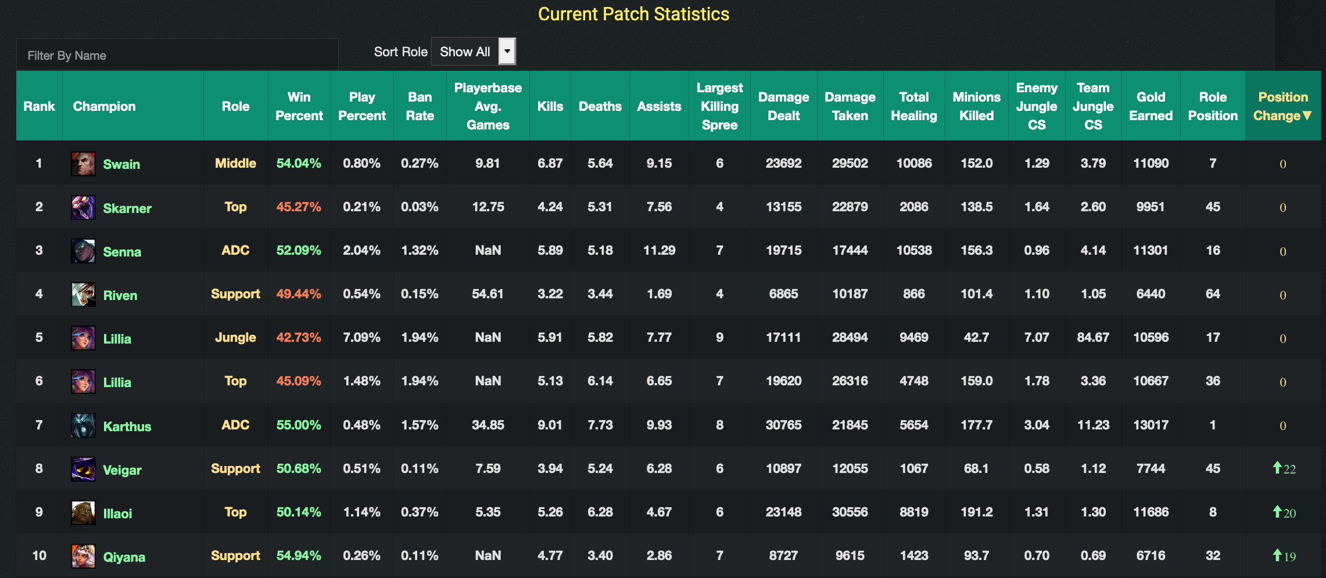
Data Sources
Analysis Workflow
Champion stats for majority of analysis
Notes:
RAJ
Purpose of the slide: Brief overview of the game

Slide 7
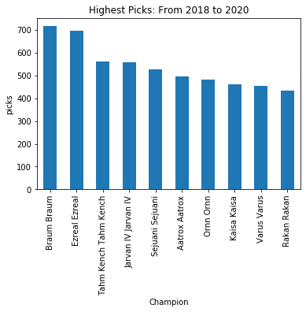
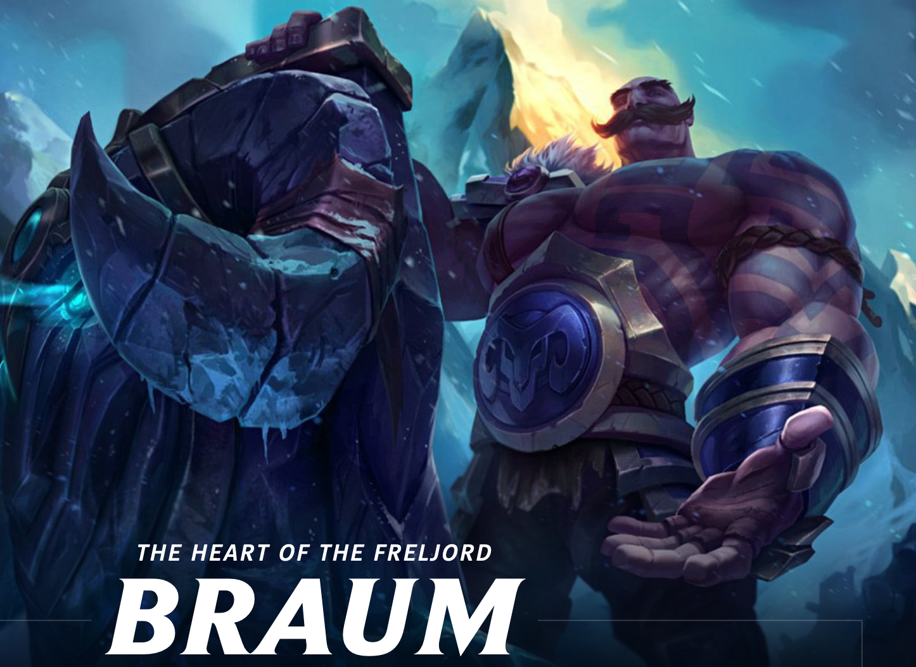

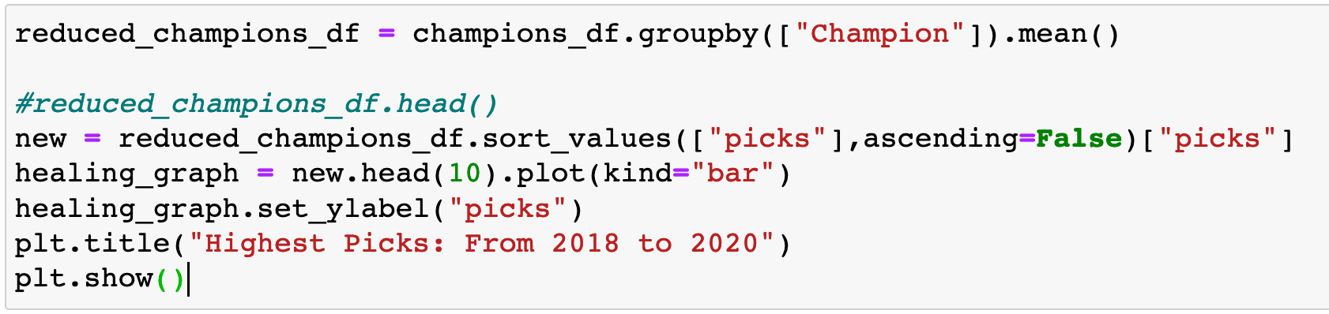
Data Exploration and Cleaning
Analysis Workflow
SUPPORT
ADC / TOP
Notes:
JIM

Slide 8
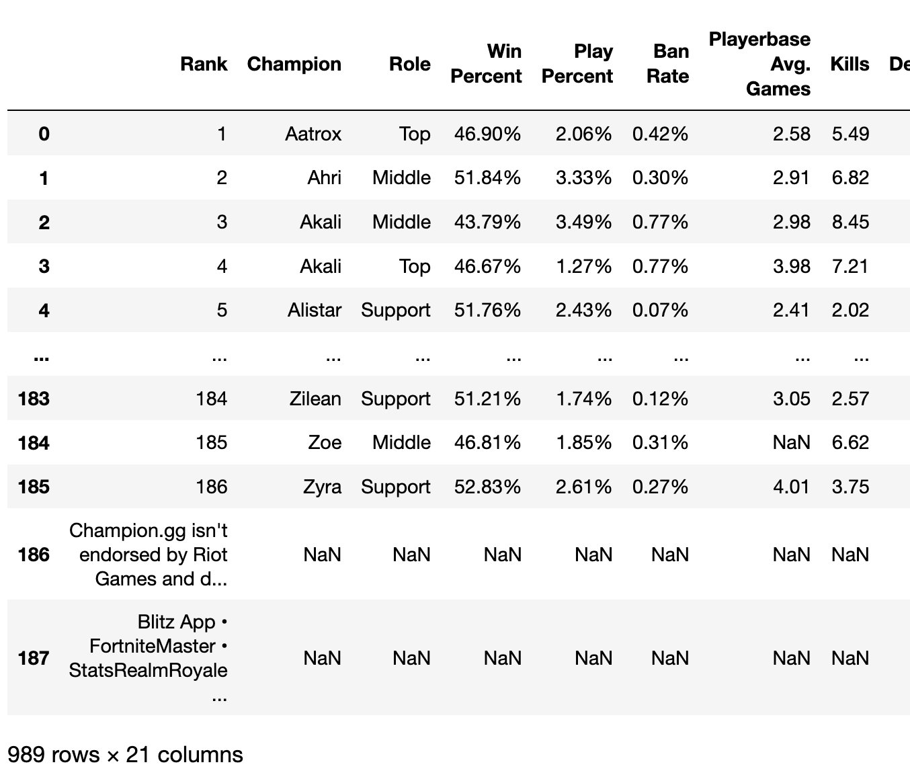
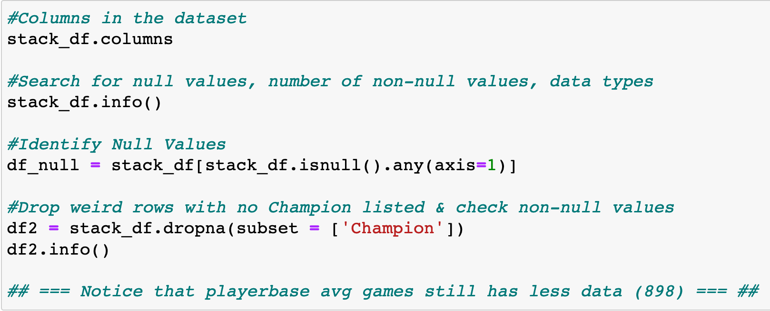

Data Exploration and Cleaning
Analysis Workflow
Analysis Workflow
YIKES!!
Notes:
JIM

Slide 9
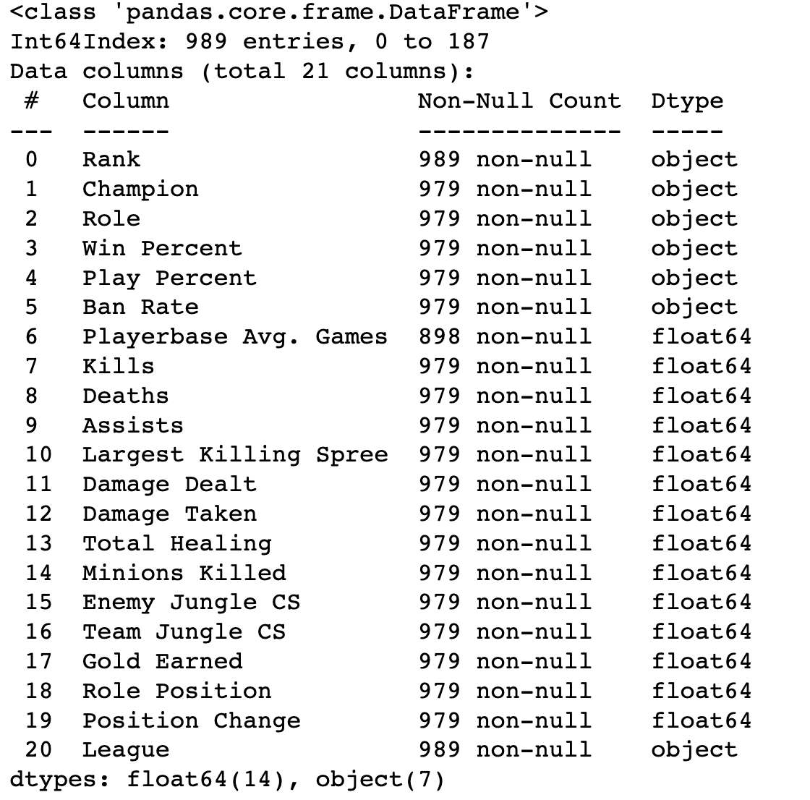
Data Exploration and Cleaning
Analysis Workflow
Notes:
JIM
Purpose of the slide: Brief overview of the game

Slide 10
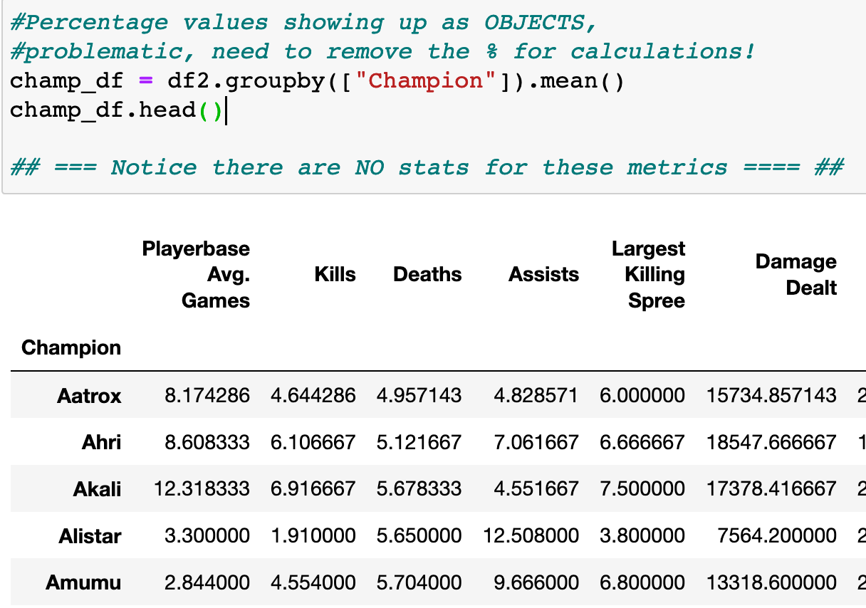
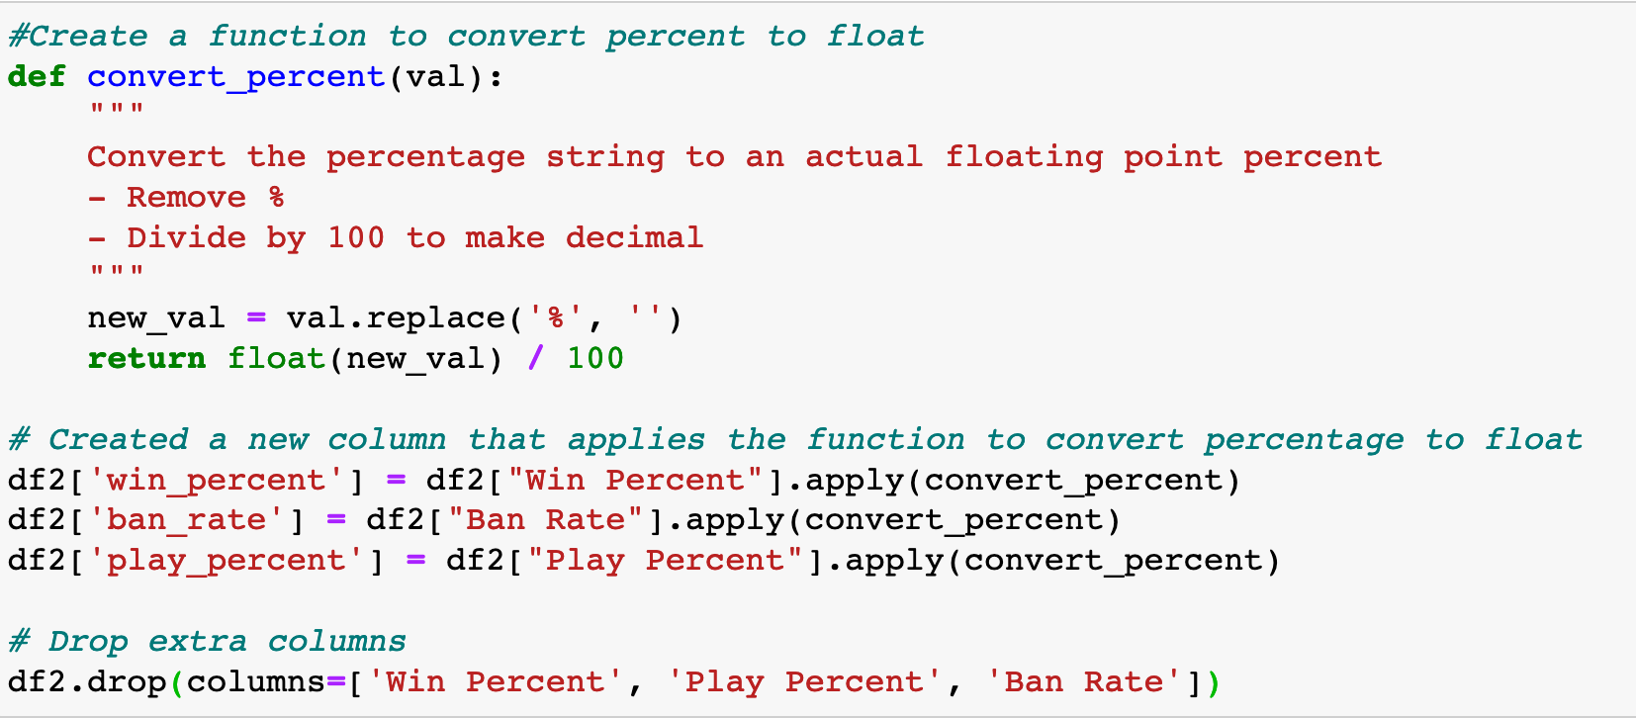
Data Exploration and Cleaning
Analysis Workflow
Notes:
JIM
Purpose of the slide: Brief overview of the game

Slide 11
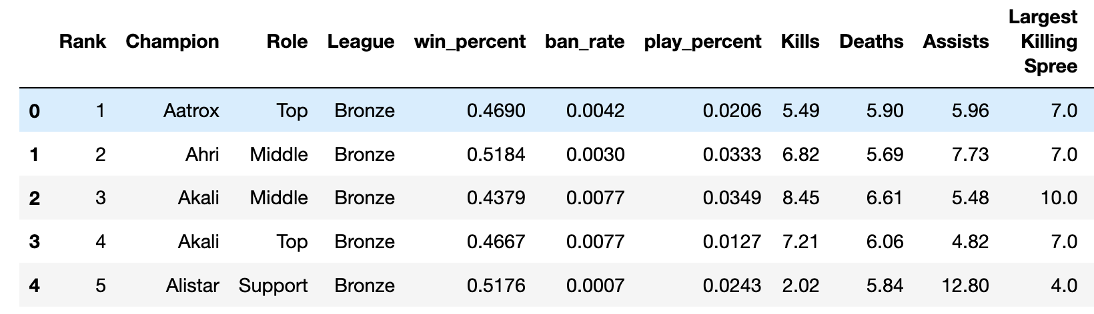
Data Exploration and Cleaning
Analysis Workflow
Notes:
JIM
Purpose of the slide: Brief overview of the game

Slide 12
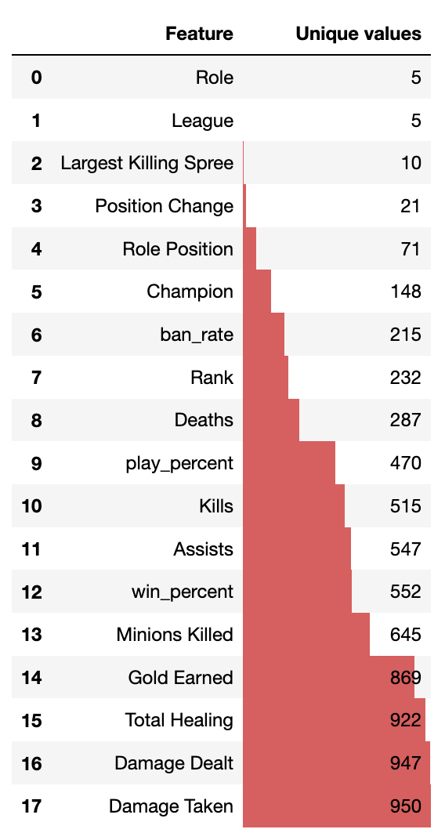
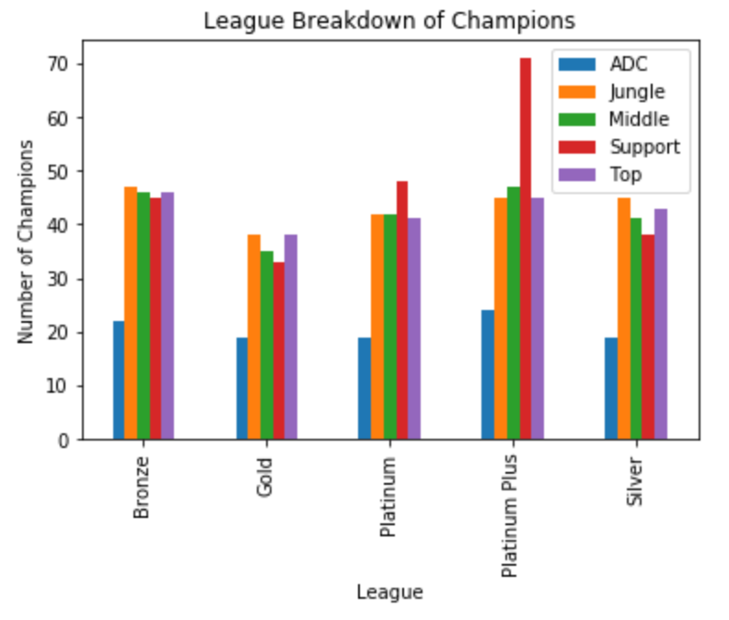
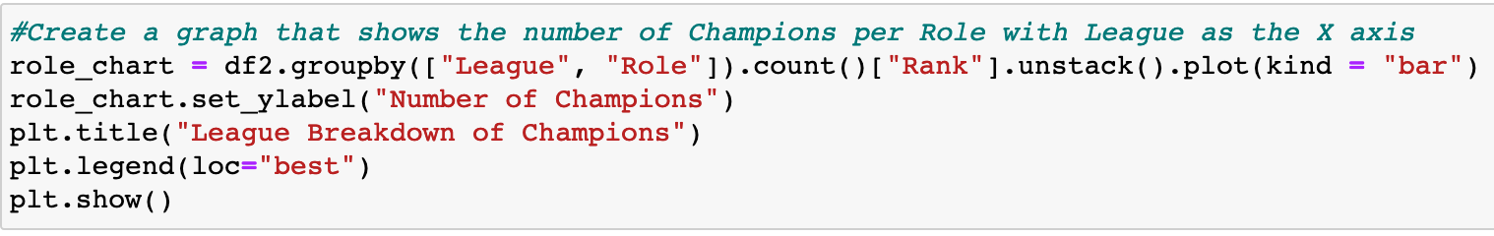
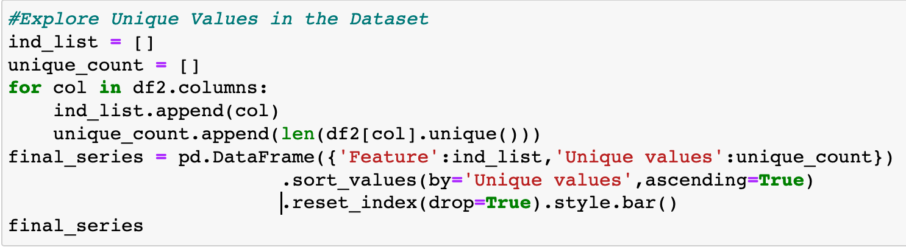
Data Exploration and Cleaning
Analysis Workflow
Notes:
RAJ
Purpose of the slide: Brief overview of the game

Slide 13
Descriptive Data Analysis
Data Workflow
Support
ADC
Middle
High total healing
High damage taken
High minion kills
Low death
High assist
High gold earned
High damage taken
High damage dealt
High kills
Low deaths
High assist
High minions kills
Jungle
Top
High minion kills
High enemy jungle
High team jungle cs
High kills
High assist
High position change
High kills
High kills spree
High minions kills
Low deaths
Notes:
RAJ

Slide 14
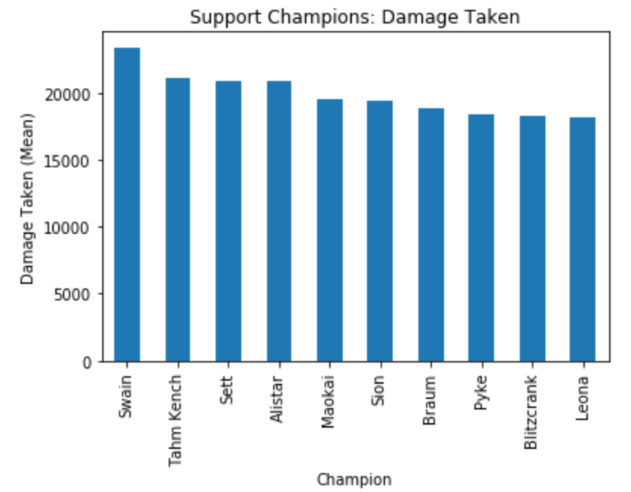
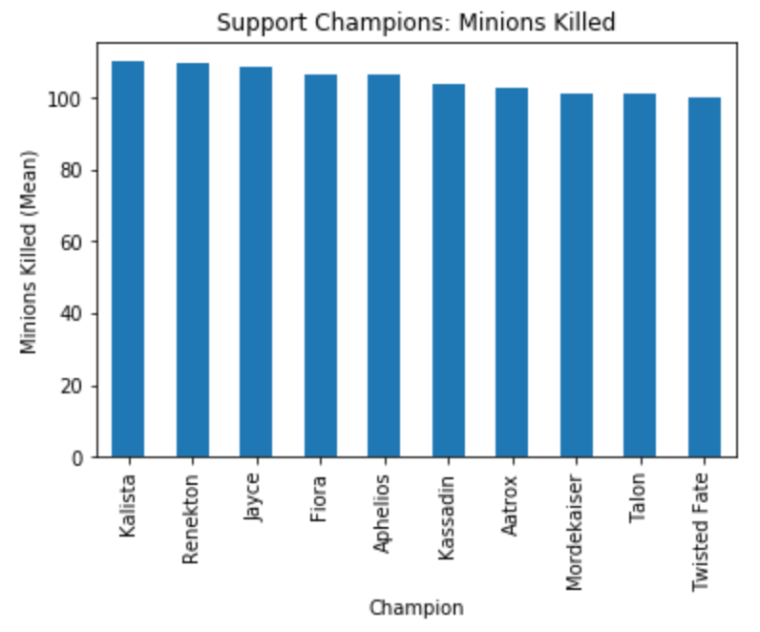
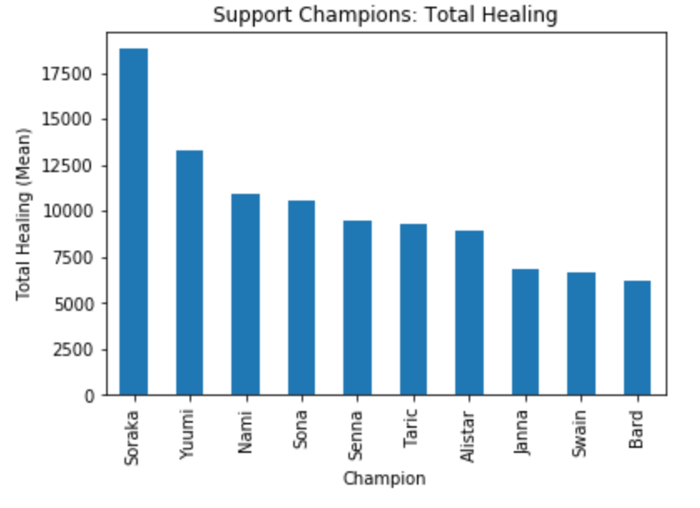
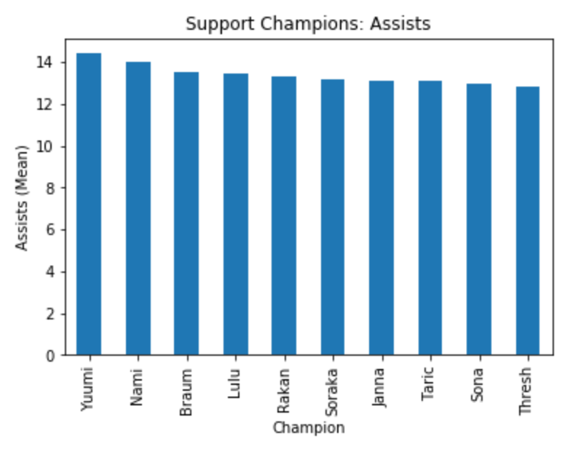
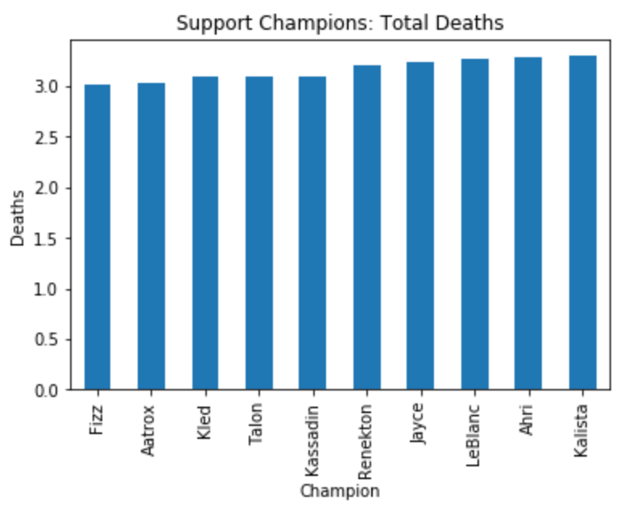
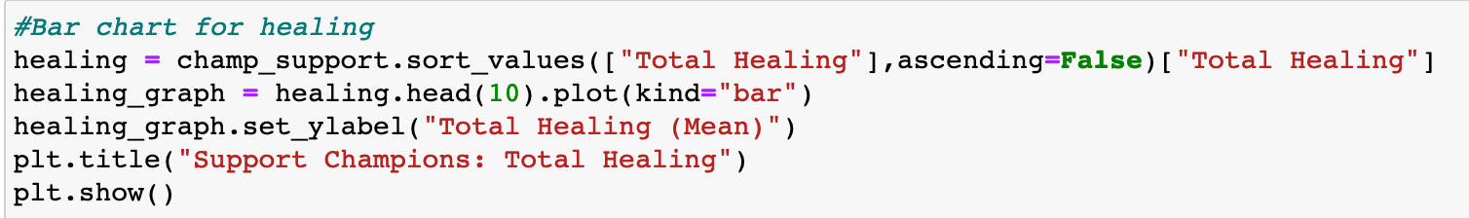
Descriptive Data Analysis
No ONE Champion stands out
Data Workflow
Notes:
JIM

Slide 15
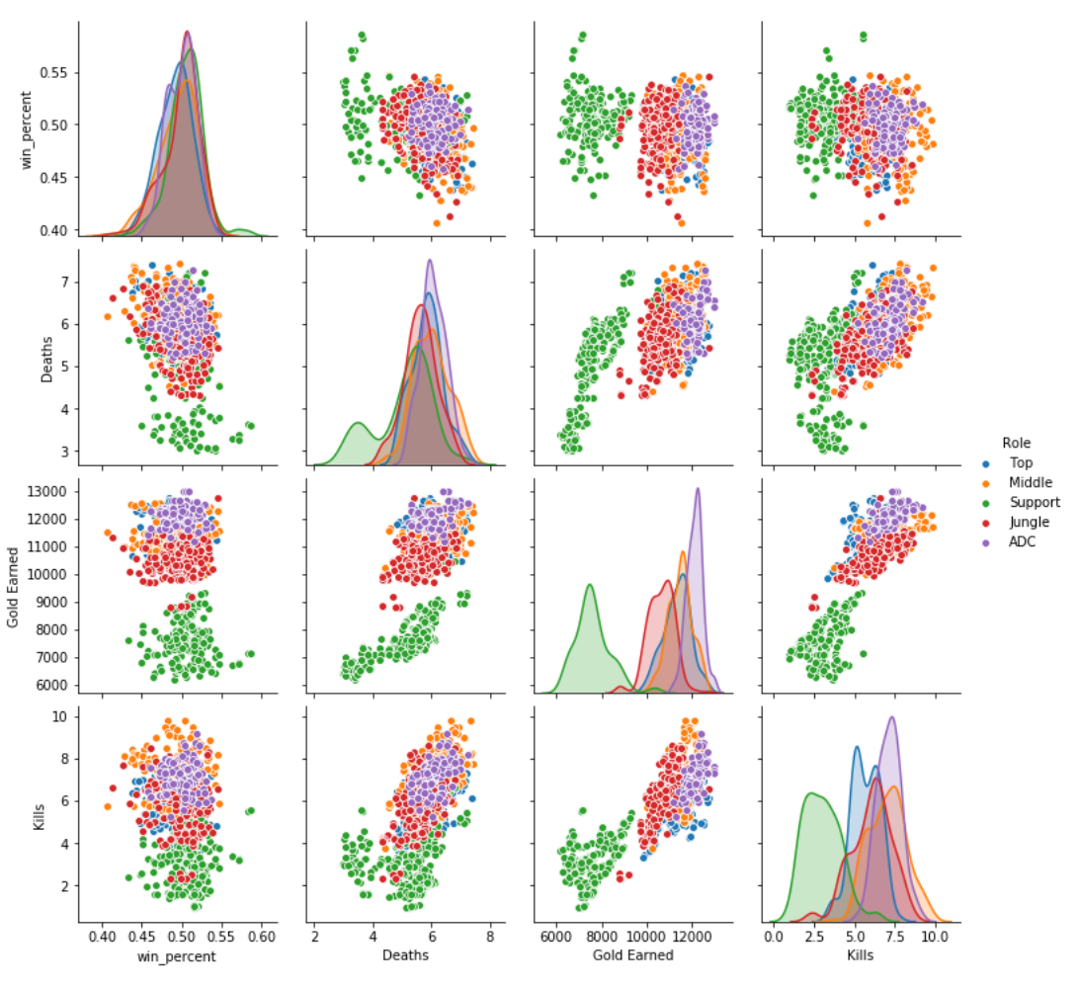
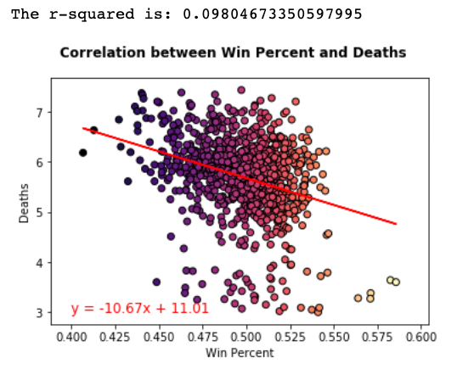
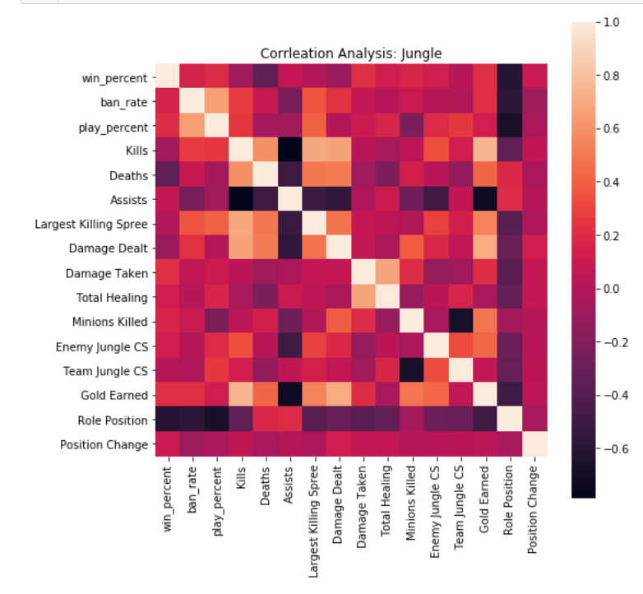
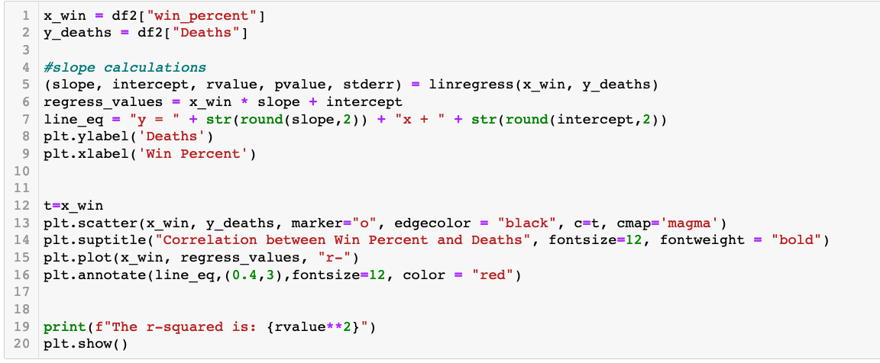
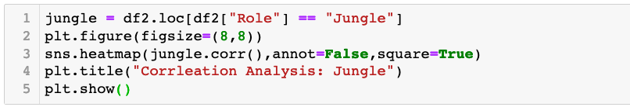

Correlation Data Analysis
No Strong Correlation
Win Percent x Single Metric
Analysis Workflow
Pearson’s
Notes:
As Jim stated, this initial analyses did not identify a single top champion based on single metrics
Graph #1
Therefore, we conducted a series of correlation analyses using linear regression and Pearson's Coefficient to determine whether ANY of the metrics correlate with Win Percentage. First, we graphed the data using a scatterplot in Matplotlib> in the example, we compared deaths vs win percent. As expected, there is a strong negative correlation, meaning the more deaths a champion has, the lower the win percentage.
Graph #2
Now, to conduct individual analyses of all metrics is quite time-consuming with lots of redundant code. Therefore, we leveraged the seaborn library, a Python data visualization tool based on matplotlib. In a single image, we use a heatmap to visually represent correlations between all metrics. White is a perfect positive correlation, and black is a perfect negative correlation.
Graph #3
An even better seaborn function is the pair plot. The pair plot allows us to visualize
First, the distribution of the data as shown in the bell-shaped curve area graphs
Secondly, a scatterplot correlation analysis and
Finally, color-code based on the champion role.
While this analysis revealed information on game rules (such that there is a strong positive correlation between gold earned and deaths for support champions but not the other roles, it also confirmed that no single metric compared to win percent is correlated. Therefore, determining the best champions requires a multifactorial approach

Slide 16
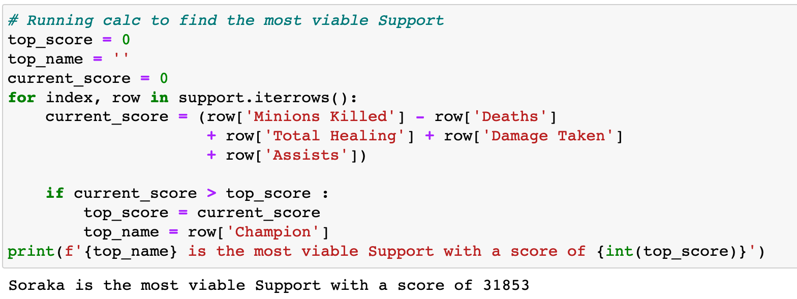
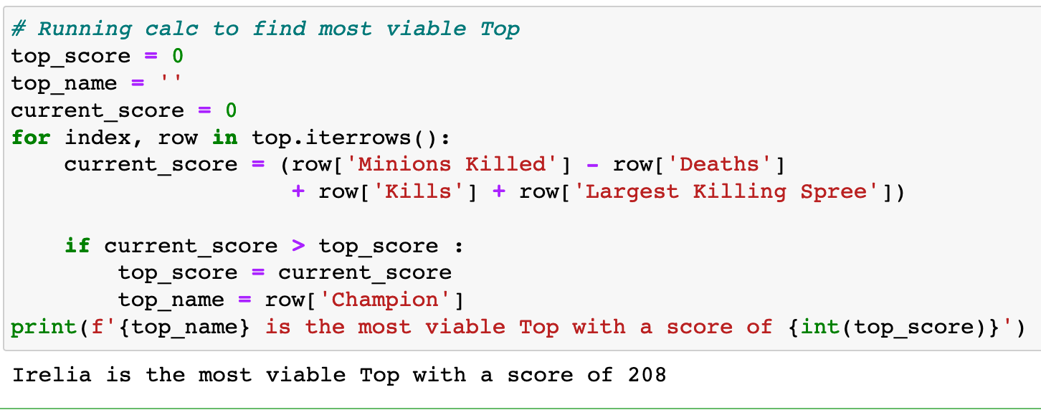
Viability Score
Analysis Workflow
This equation was designed to take the most important metrics and use them to create an overall viability score. Using this score we can find the most effective champion in their respective role.
Notes:
DYLAN

Slide 17

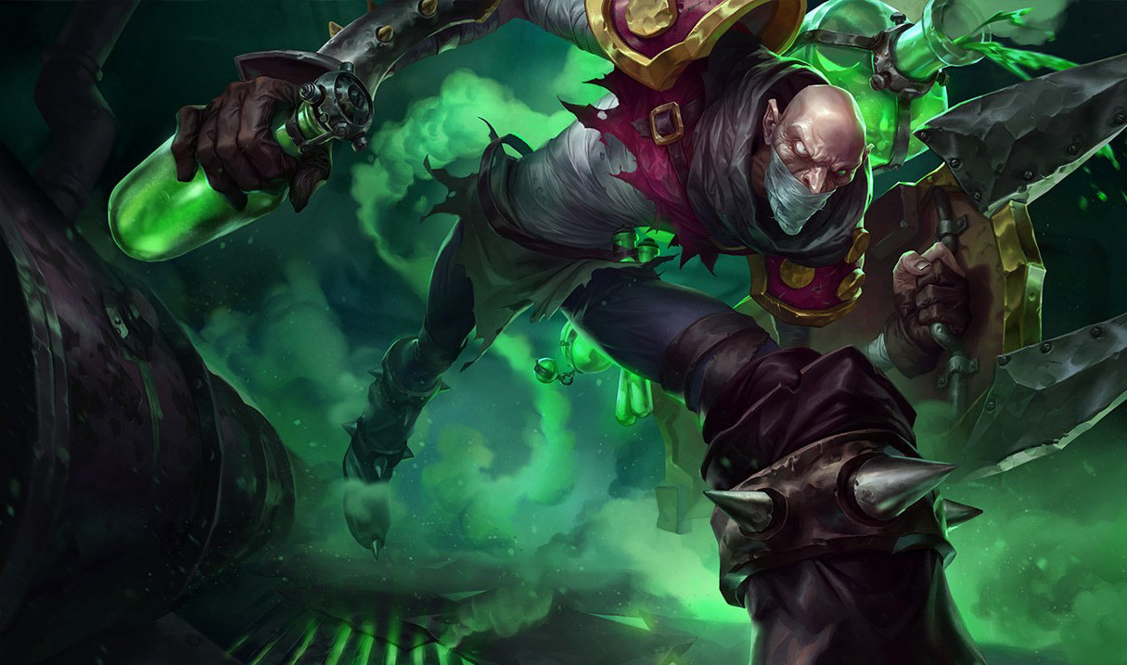
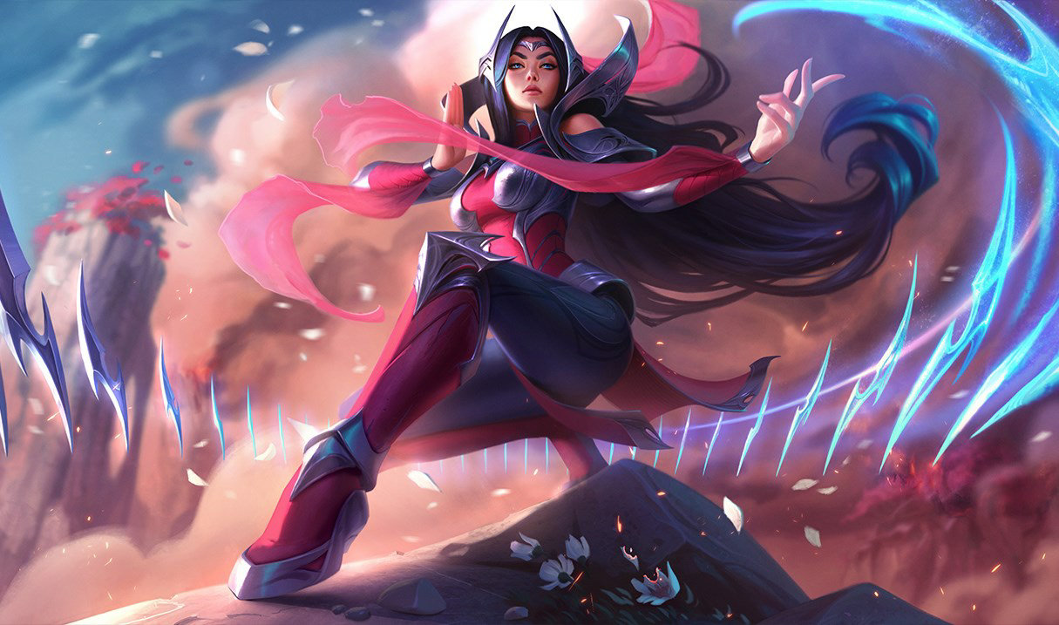
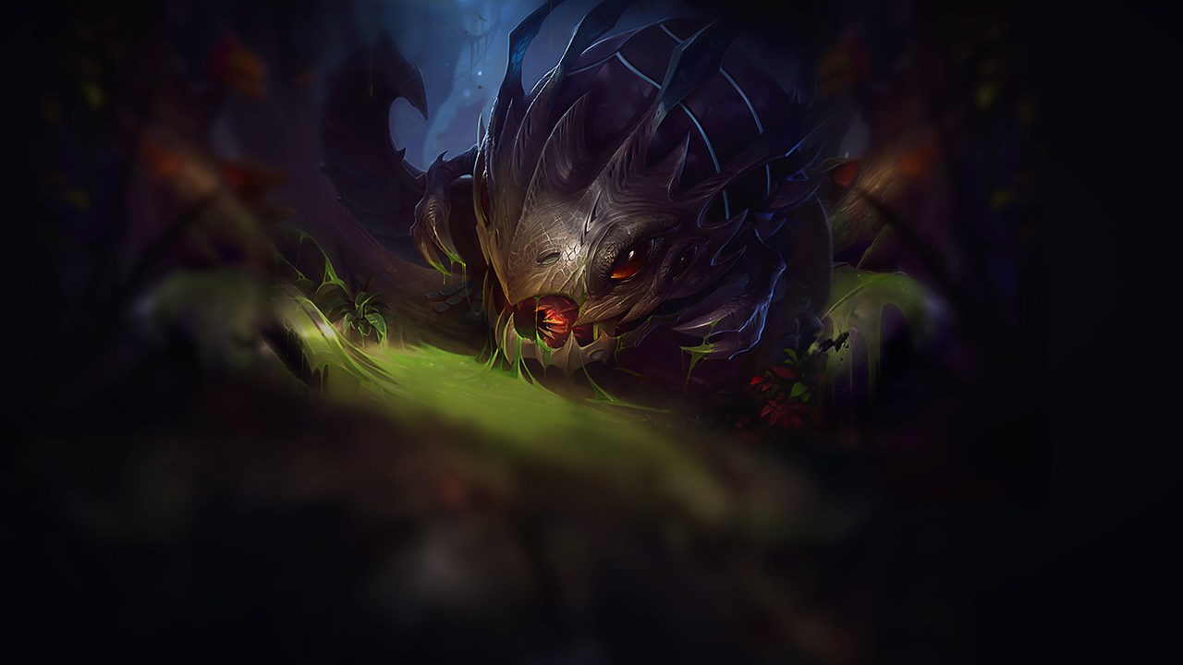
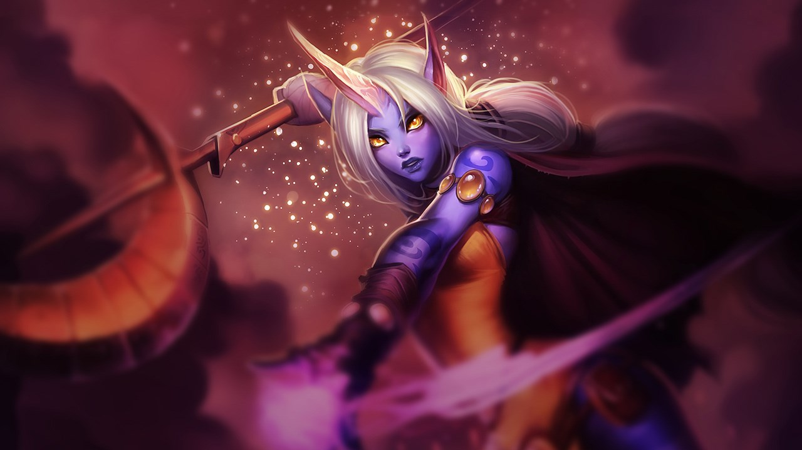
Super Squad
Middle
Jungler
Top
Karthus
Signed
Irelia
ACD
Support
Kog’Maw
Soraka
Notes:
DYLAN

Slide 18







Analysis Summary
Conclusions and Post-Mortem
Dataset
Analysis
Utilized Kaggle datasets from second-hand APIs
Required mild cleaning and merging of datasets
Top 10 analysis did not identify obvious champions
Correlation analysis provided insight into roles but no strong correlation with win percent
Viability Score
Improving Analysis
Rather than look at single metric, we combined our knowledge of the game with key metrics to create a viability score
1. Utilize Riot API for real-time data
2. More statistics on game play rather than character attributes
Notes:
Dataset is not current
Ability to collect real-time data with Riot API
Complex question!
No one variable greatly influences winning
Its HOW you play the character to not WHICH character
Collect more statistics on game play
Towers taken, first blood, etc.

